Slide 1
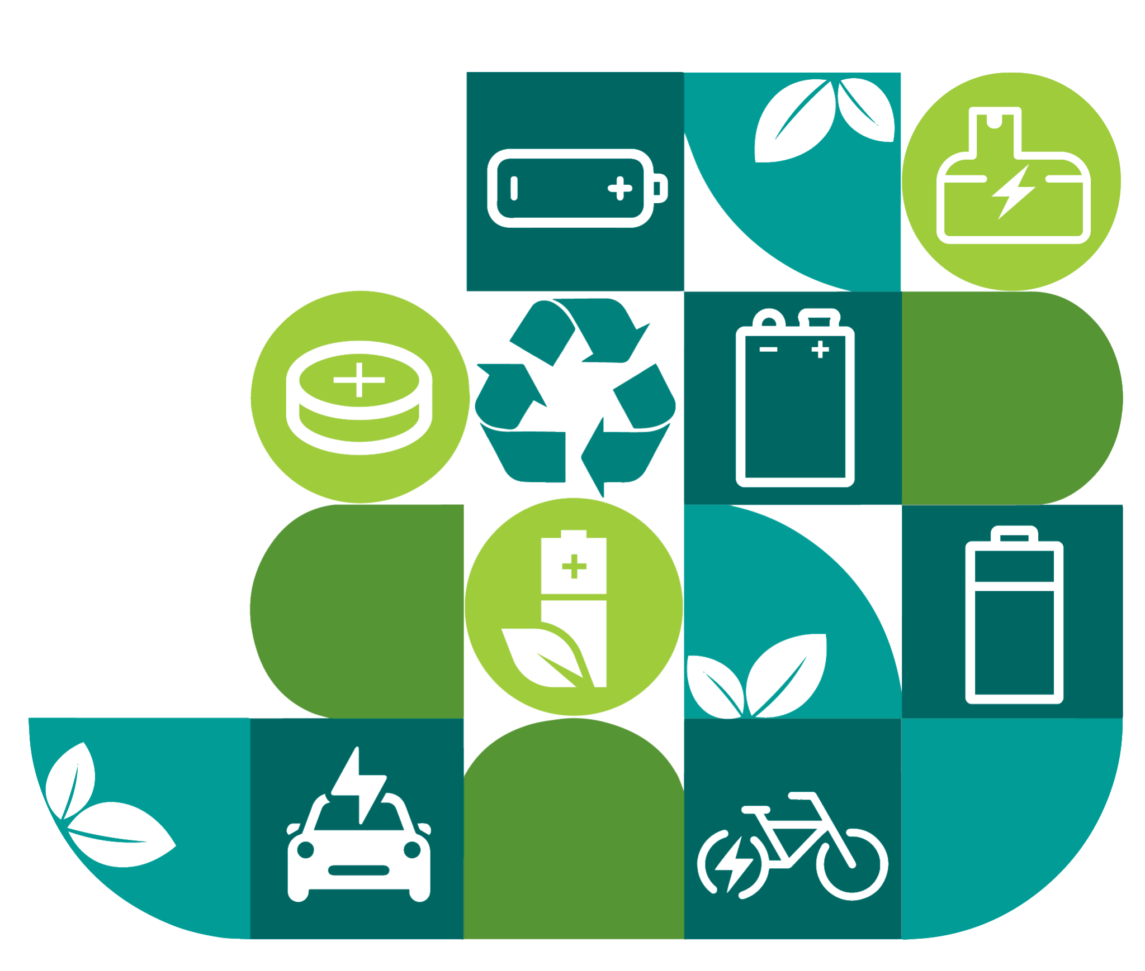
Battery Recycling Drive
Drive-up Donation Service!
Take Charge!
Recycle Batteries Responsibly.
Popular Items to Bring:
Cell Phones
Rechargeable Batteries
Household Batteries
Please contact us for more information!

